Slide 1
ConvNets
Dr. Hasan Firdaus Bin Mohd Zaki
Acknowledgements: Materials for this slide were adapted from MIT deep learning, learnopenCV, and UWA

Slide 2
Lets learn together!
Foundations of CNN
Feature extraction using CNN
CNN for classification
CNN beyond classification
Impacts of CNN

Slide 3
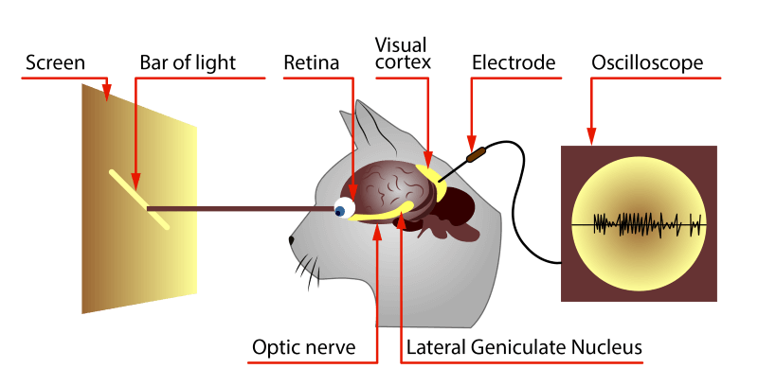
The Visual Cortex
1) Spatial Invariance
2) Receptive Field
3) Hierarchy

Slide 4
The Visual Cortex

Slide 5

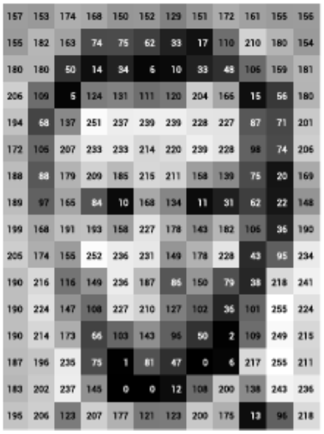
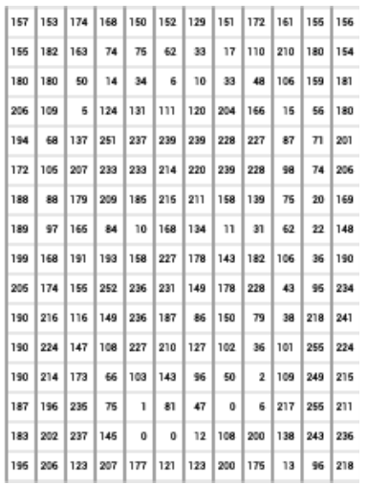
What Computers “See”
What the computers see
An image is just a matrix of numbers [0,255]!
i.e., 1080x1080x3 for an RGB image

Slide 6
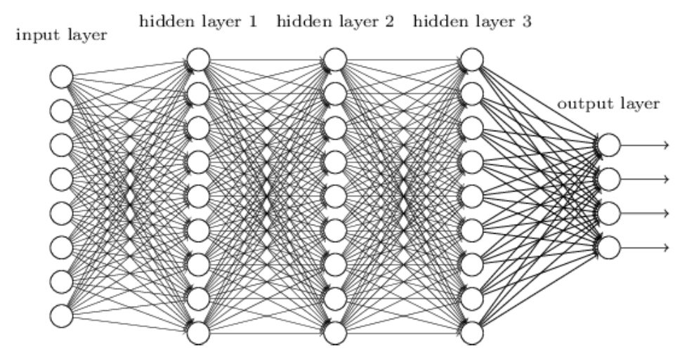
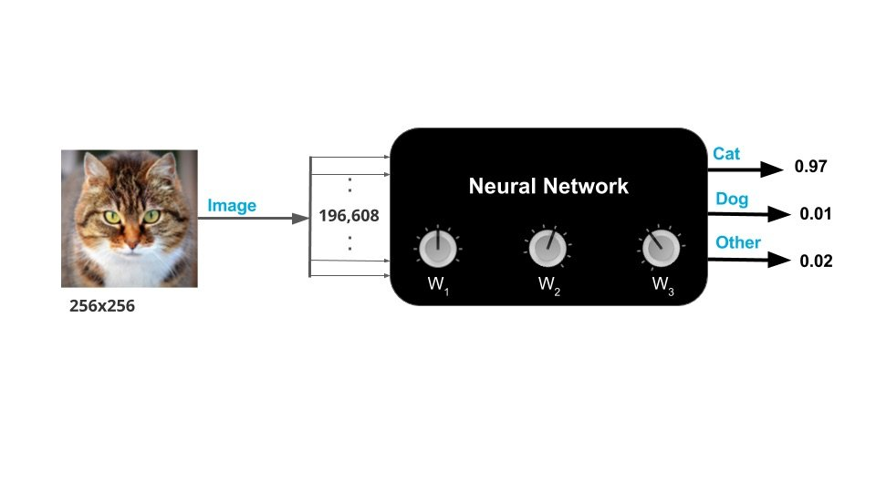
Fully Connected Neural Network

Slide 7
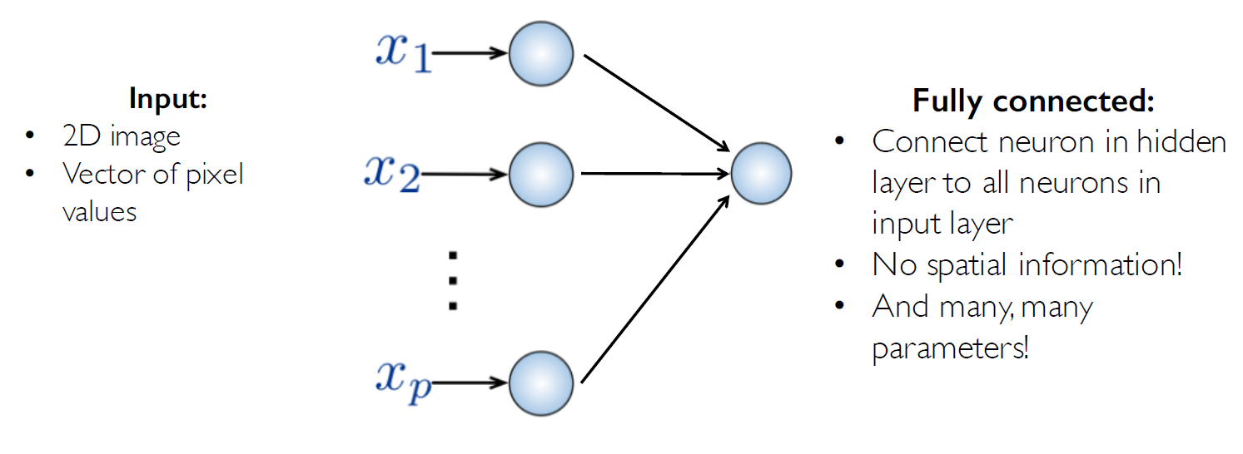
Fully Connected Neural Network
How can we use spatial structure in the input
to inform the architecture of the network?

Slide 8
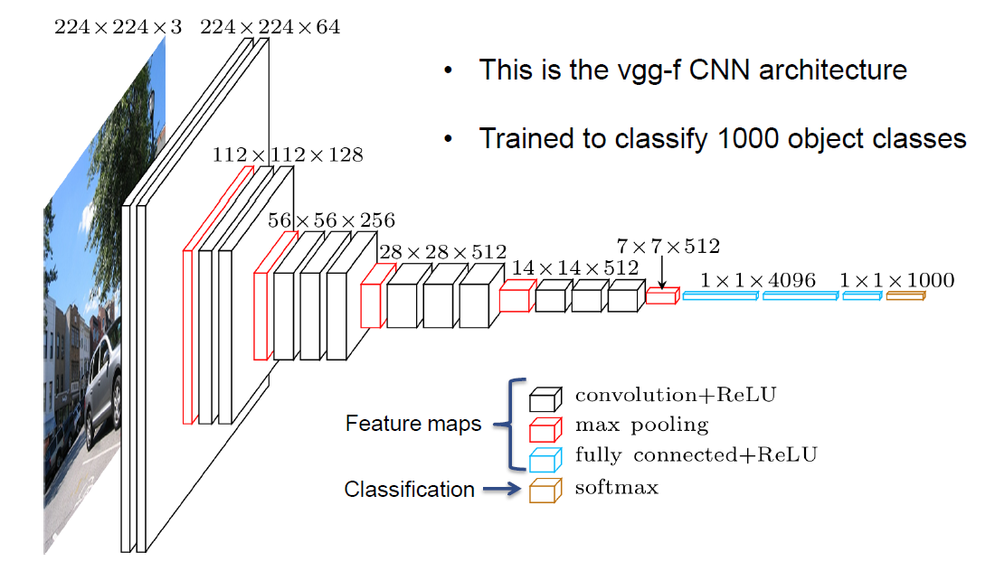
Convolutional Neural Networks

Slide 9
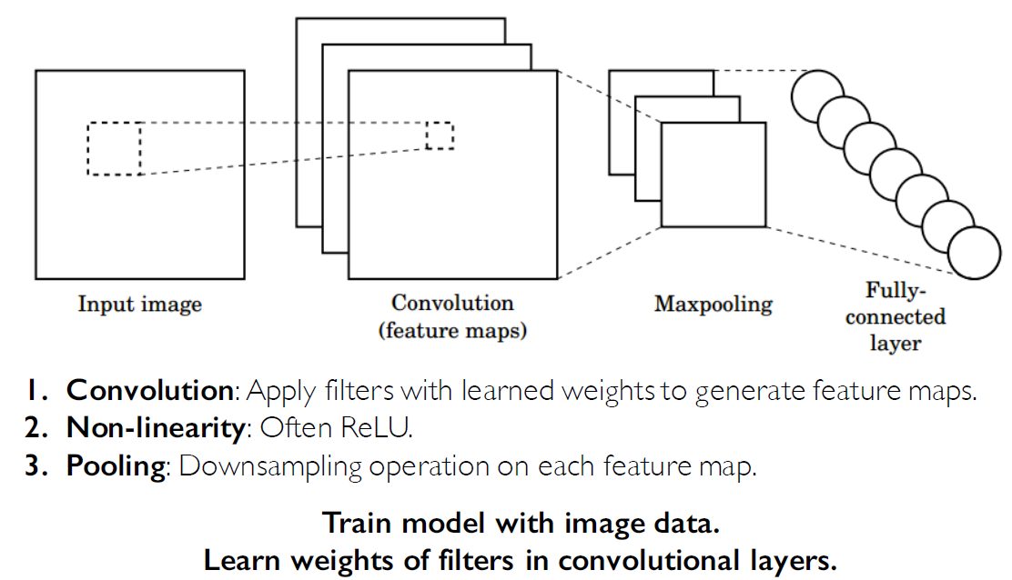
CNNs for Classification

Slide 10
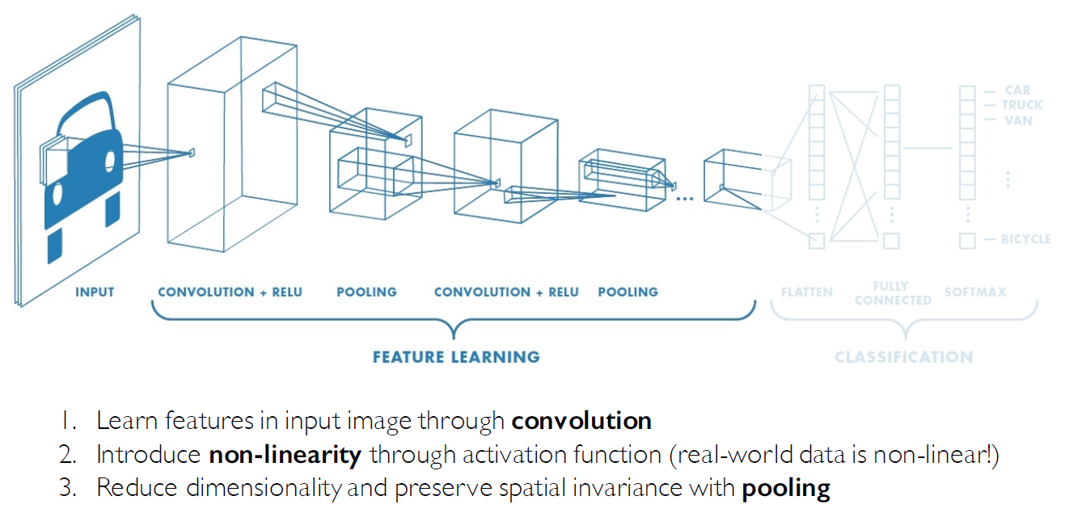
CNNs for Classification: Feature Learning

Slide 11
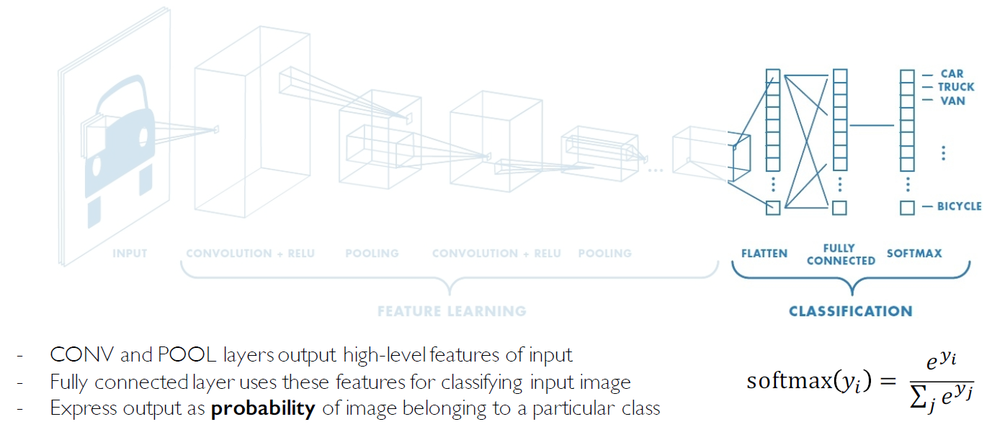
CNNs for Classification: Class Probabilities

Slide 12
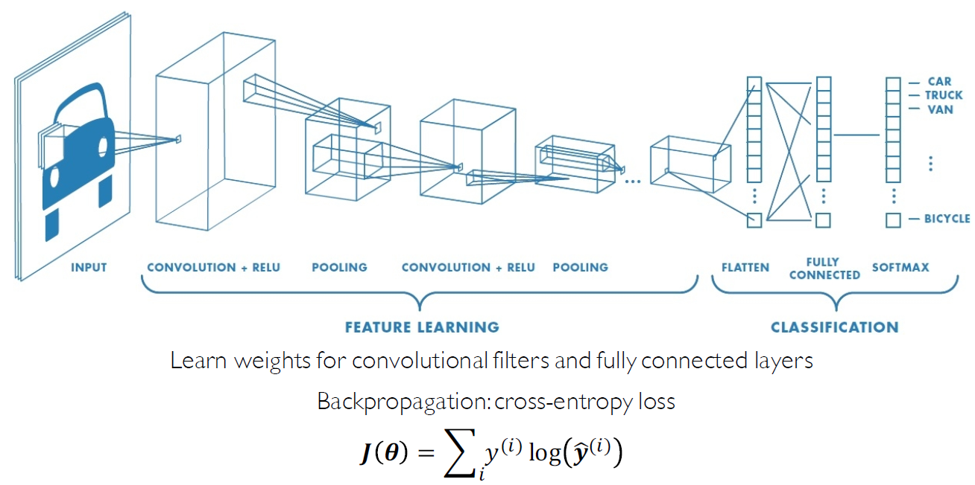
CNNs: Training with Backpropagation

Slide 13
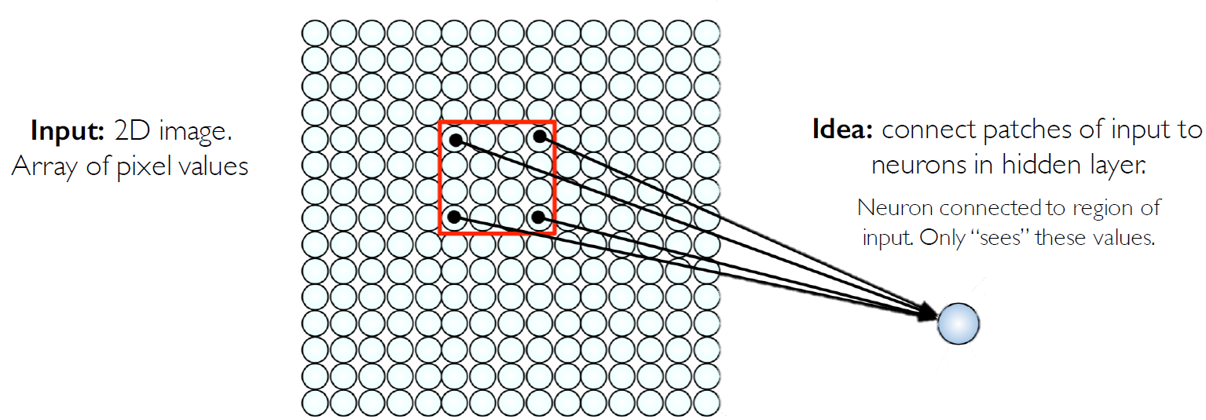
Using Spatial Structure
The idea is to retain the 2D nature of the image so that we don’t lose its spatial structure

Slide 14
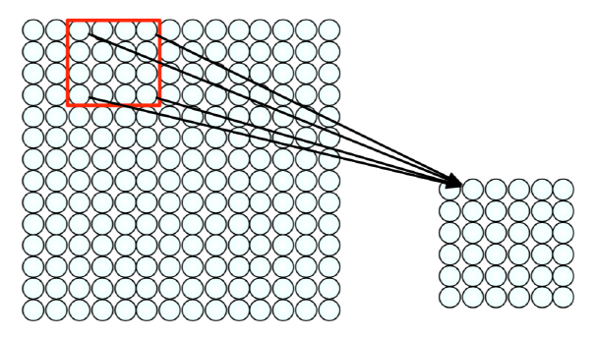
Feature Extraction with Convolution
- Filter of size 4x4 : 16 different weights
Apply this same filter to 4x4 patches in input
Shift by 2 pixels for next patch
* Depends on your architecture design
This “patchy” operation is convolution
1) Apply a set of weights – a filter – to extract local features
2) Use multiple filters to extract different features
3) Spatially share parameters of each filter

Slide 15
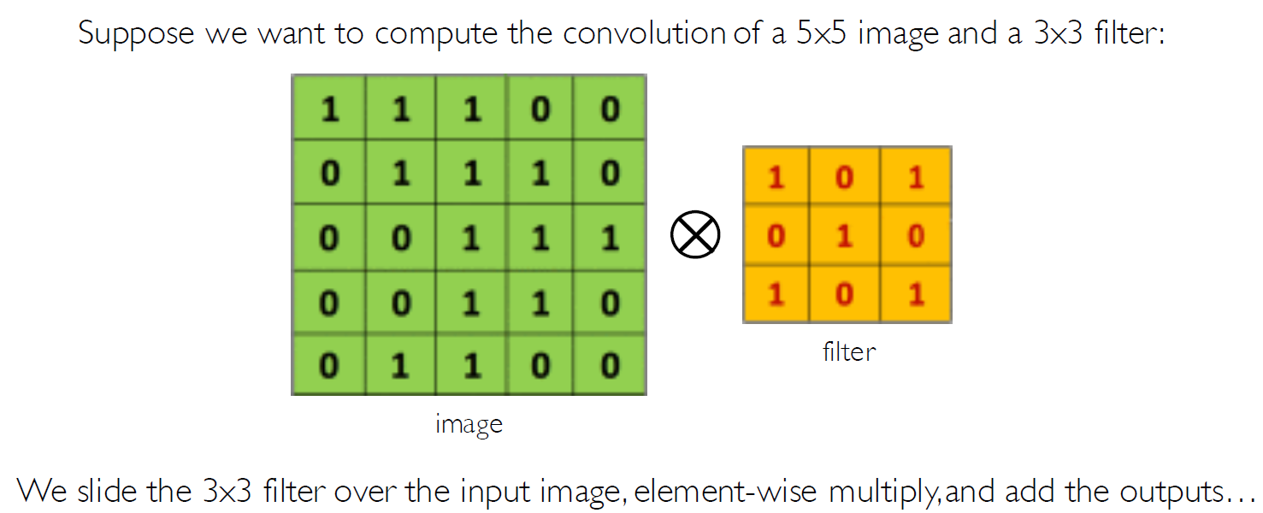
The Convolution Operation

Slide 16
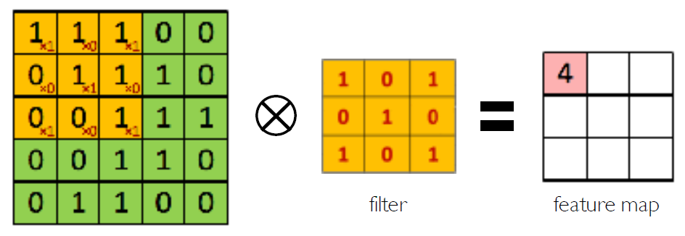
The Convolution Operation
We slide the 3x3 filter over the input image, element-wise multiply, and add the outputs:

Slide 17
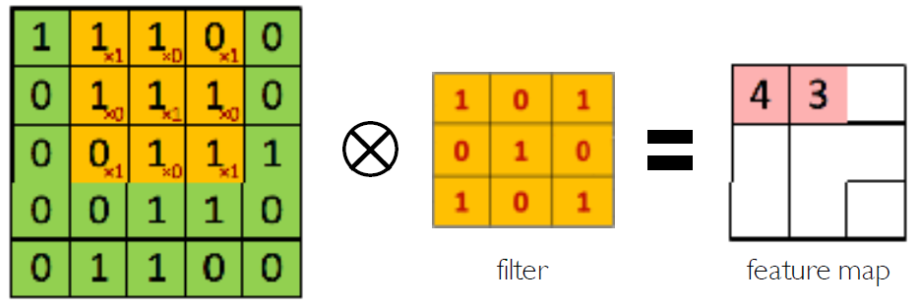
The Convolution Operation
We slide the 3x3 filter over the input image, element-wise multiply, and add the outputs:

Slide 18
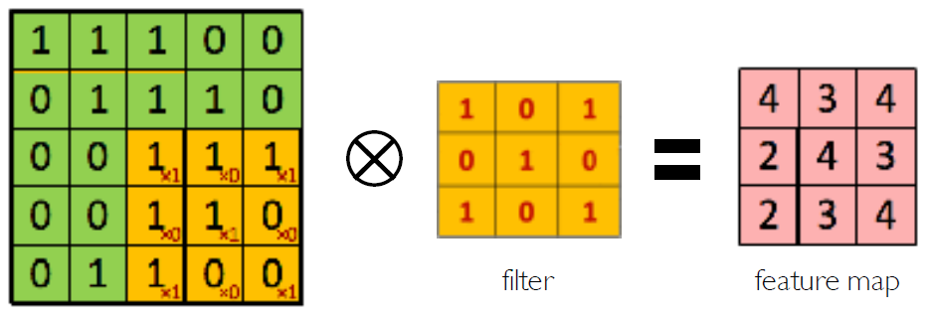
The Convolution Operation
We slide the 3x3 filter over the input image, element-wise multiply, and add the outputs:

Slide 19
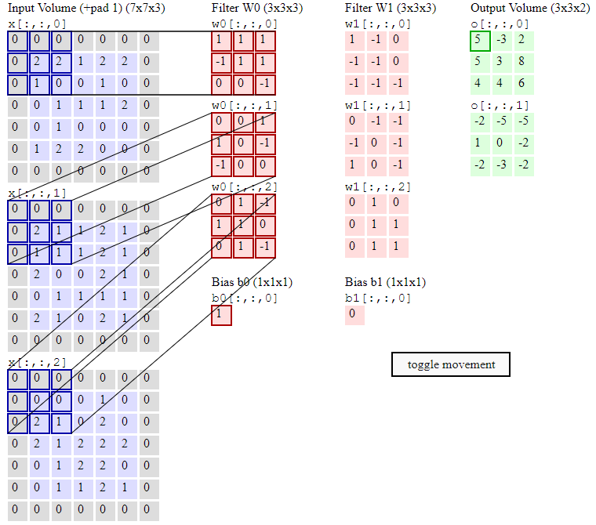
Weight Sharing
http://cs231n.github.io/assets/conv-demo/index.html

Slide 20
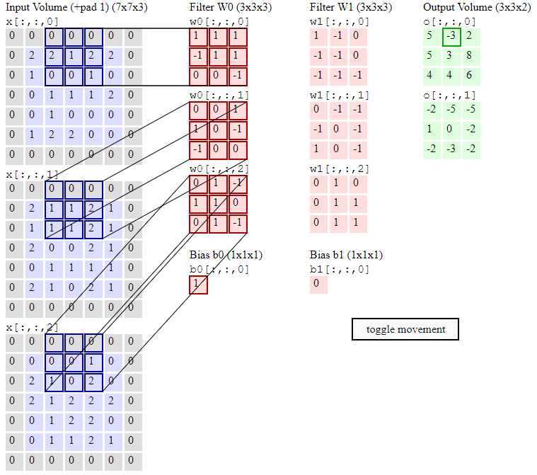
Weight Sharing
http://cs231n.github.io/assets/conv-demo/index.html

Slide 21
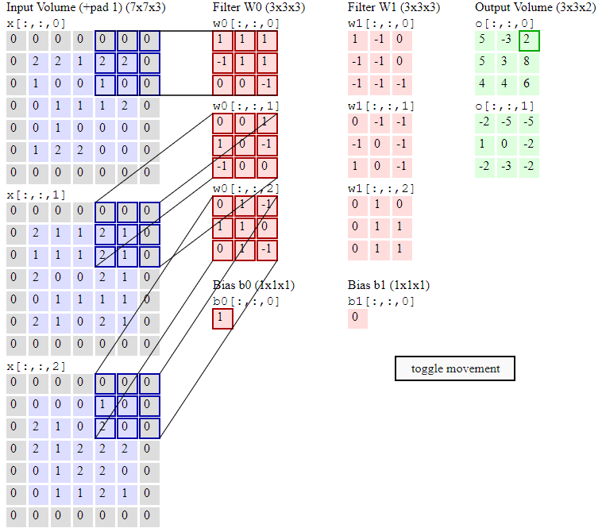
Weight Sharing
http://cs231n.github.io/assets/conv-demo/index.html

Slide 22
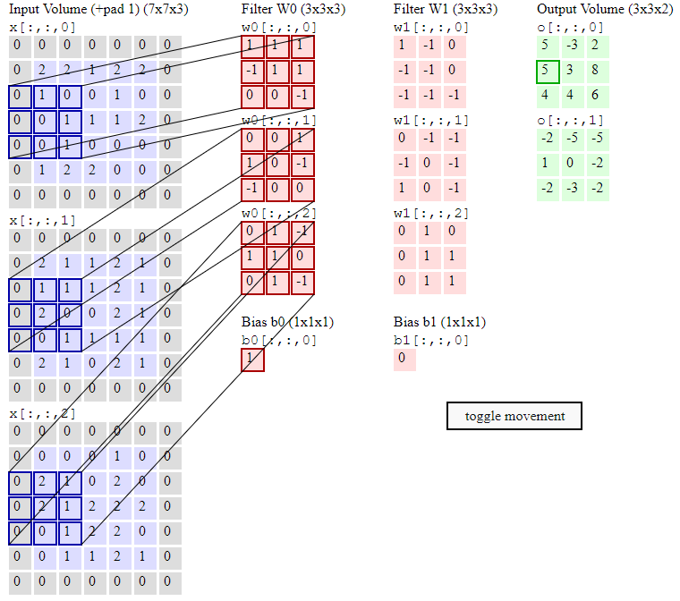
Weight Sharing
http://cs231n.github.io/assets/conv-demo/index.html

Slide 23
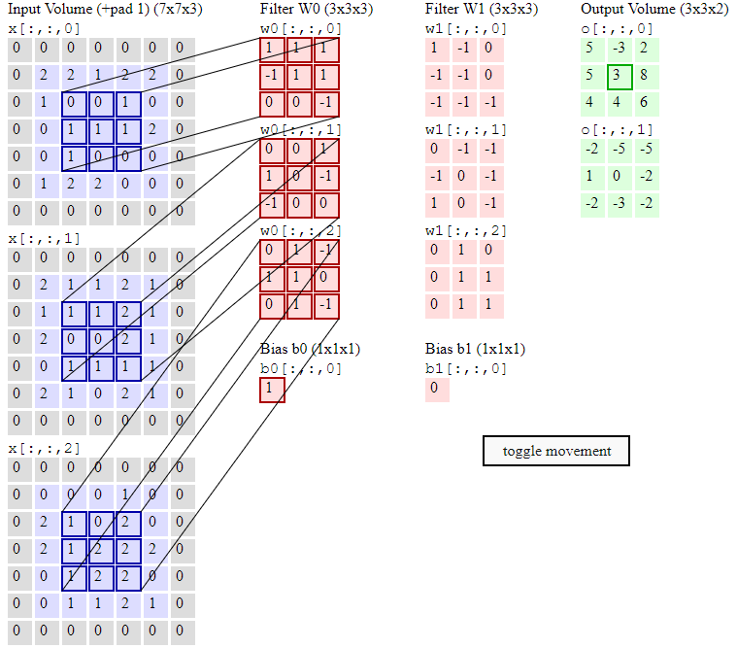
Weight Sharing
http://cs231n.github.io/assets/conv-demo/index.html

Slide 24
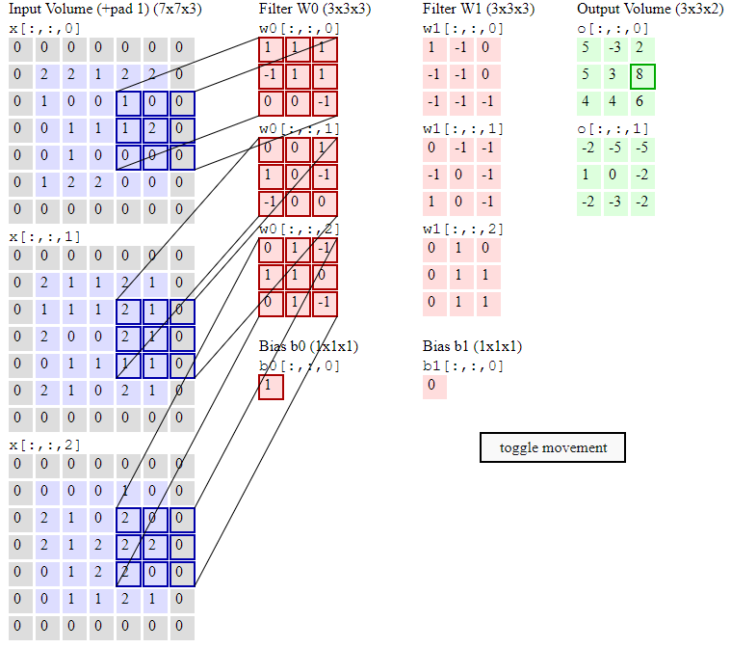
Weight Sharing
http://cs231n.github.io/assets/conv-demo/index.html

Slide 25
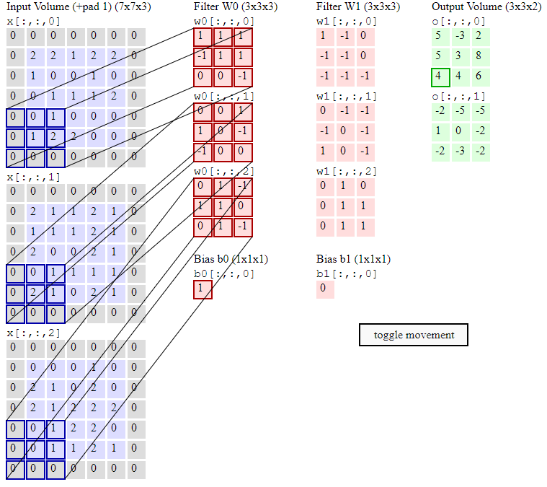
Weight Sharing
http://cs231n.github.io/assets/conv-demo/index.html

Slide 26
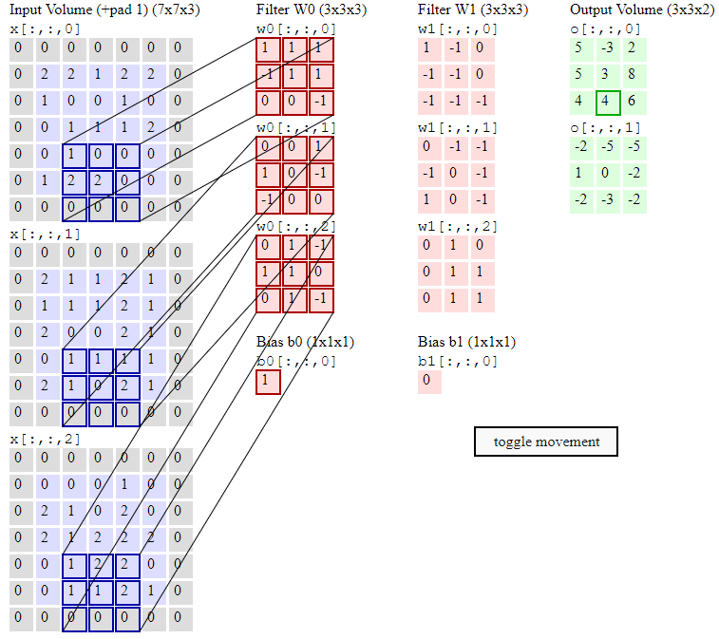
Weight Sharing
http://cs231n.github.io/assets/conv-demo/index.html

Slide 27
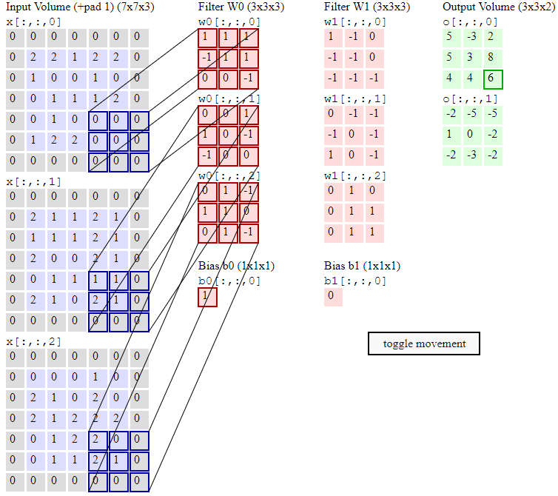
Weight Sharing
http://cs231n.github.io/assets/conv-demo/index.html

Slide 28
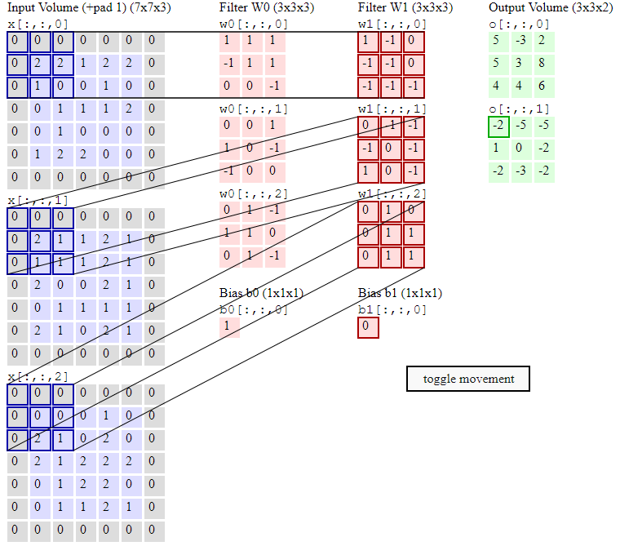
Weight Sharing
http://cs231n.github.io/assets/conv-demo/index.html

Slide 29
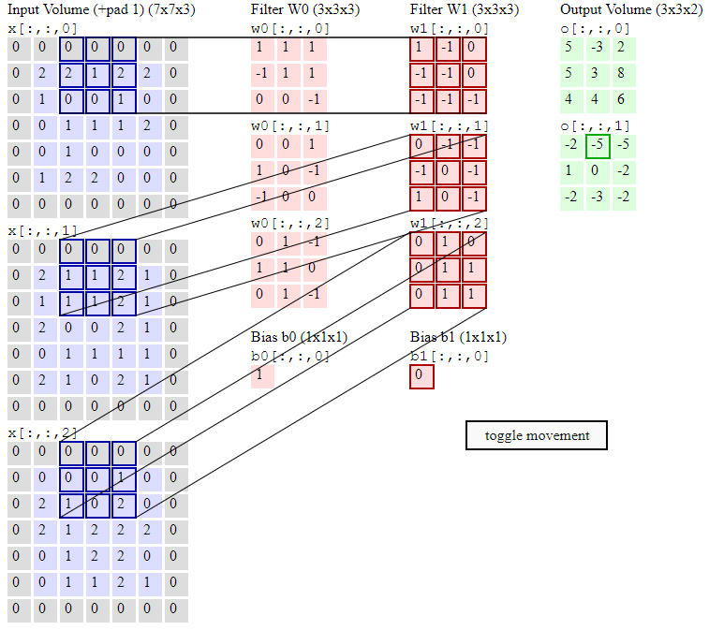
Weight Sharing
http://cs231n.github.io/assets/conv-demo/index.html

